Slide 1

Traffic Violations Analysis
UCI Data Analytics Boot Camp - September 2018 Team 6: Simon, Parno, Lalita, Michael

Slide 2
Motivations and Questions
We examined traffic citations data to answer the following questions:
How does gender impact traffic citations?
Does police use race profiling to stop drivers of certain race?

Slide 3
Data Sources
Main data source: https://data.montgomerycountymd.gov/api/views/4mse-ku6q/rows.csv?accessType=DOWNLOAD
cvs file with 1,373,693 rows
Includes data for 50 states from 2012 through August 9th, 2018
35 columns taken for entire 50 states across USA
Data source used for normalization: https://www.census.gov/quickfacts/fact/table/US/PST045217
United States Census QuickFacts, provides statistics for all states and counties, and for cities and towns with a population of 5,000 or more.

Slide 4
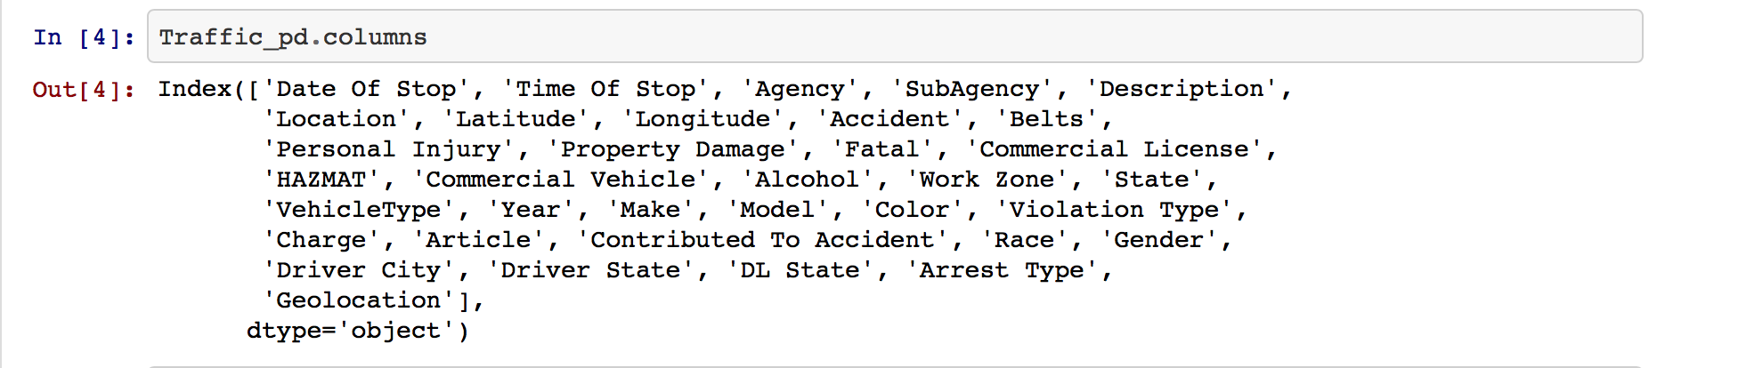
Data Cleaning Steps
Original CSV contained 35 columns:
2. Get the Description for Charge using the search string :

Slide 5
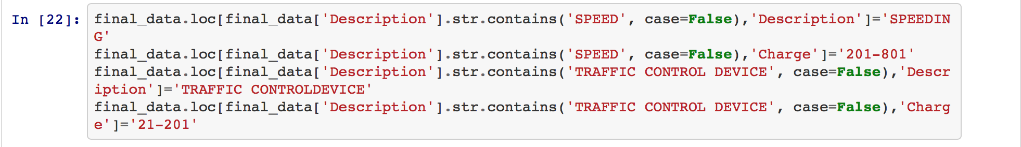
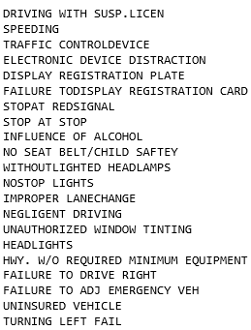
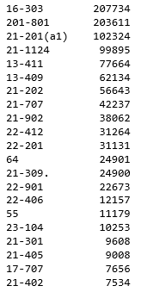
Data Cleaning Steps
203611 Description with unique names where combine with 31
charges under one Description “SPEEDING”
Repeat step 4 for top 20 Charges.

Slide 6
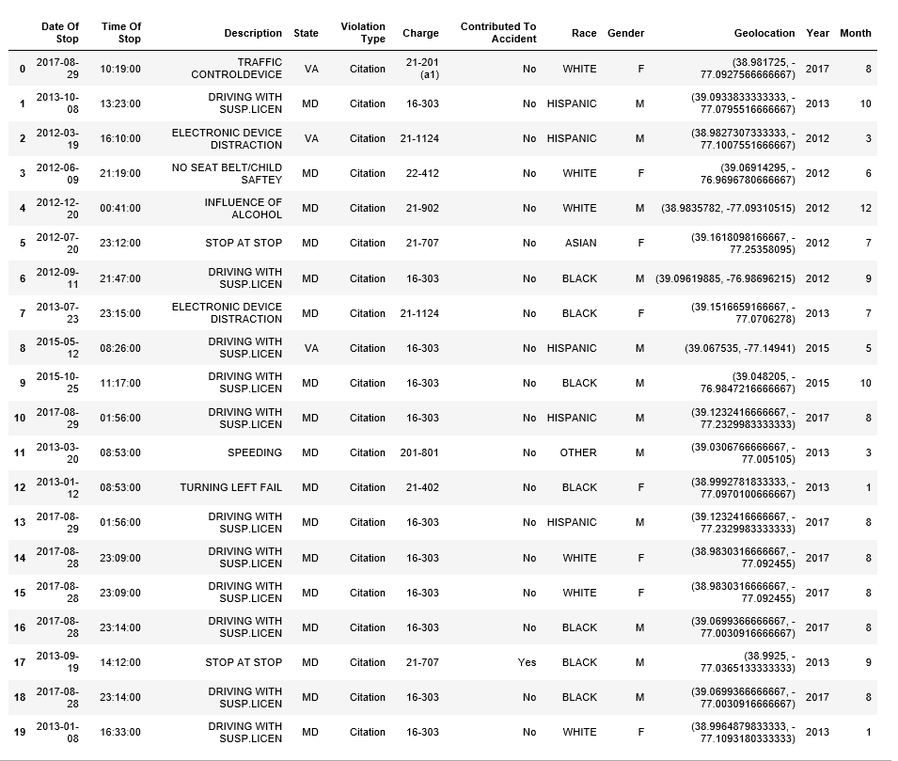
Data Cleaning Steps
Finally, create a new csv file to include top 20 Charges and Description:

Slide 7
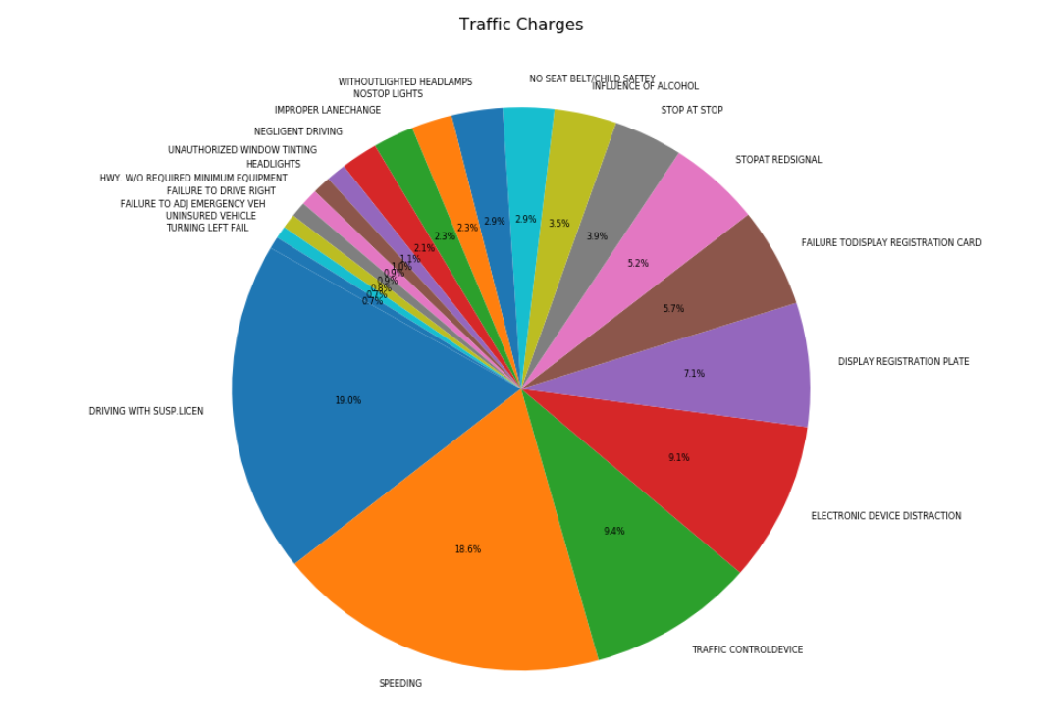
Data Cleaning Results
The following pie chart is the result of the data cleaning and it depicts most common charges.
We picked the top five charges.

Slide 8
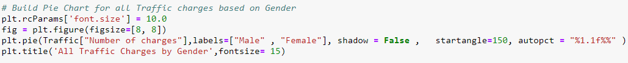
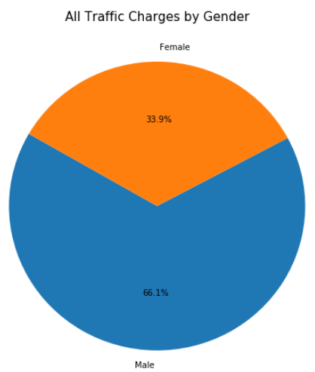
Traffic Charges by Gender
Plot pie chart for each gender:
Male drivers get most of the charges.
Limitation: this could be due to more male drivers on the road.

Slide 9
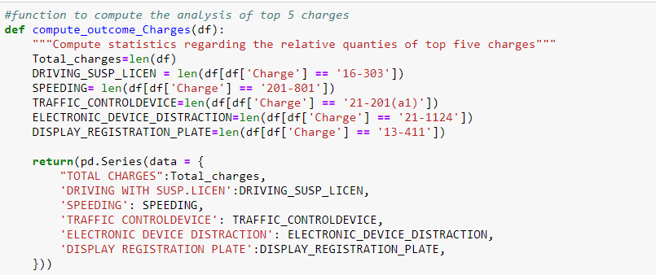
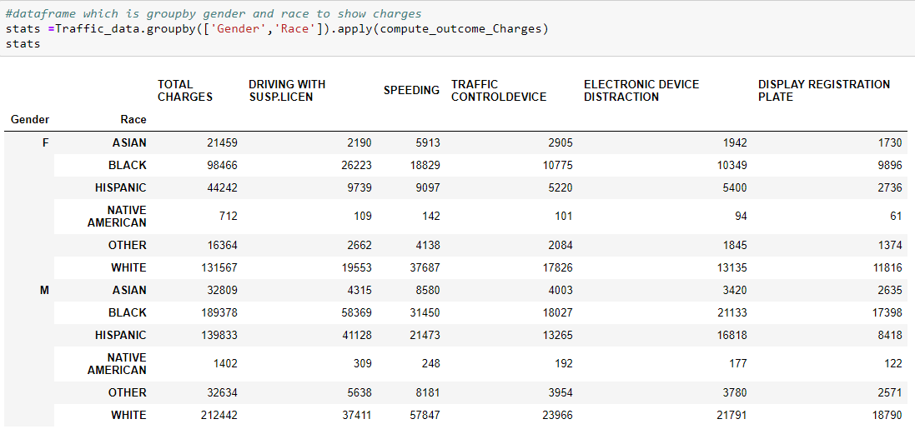
Traffic Charges by Race and Gender
Function below returns the count of top 5 traffic charges:
Return results: the count of top 5 traffic charges:

Slide 10
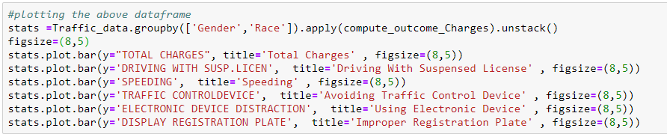
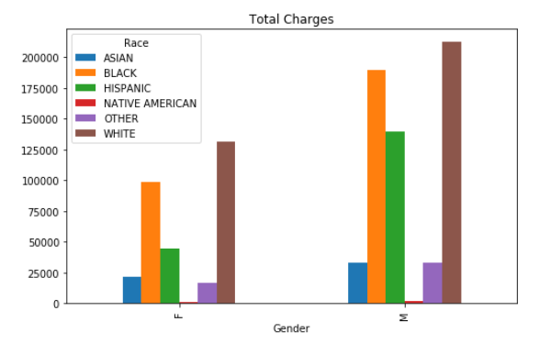
Traffic Charges by Race and Gender
Plot bar charts for race and gender, using top 5 traffic charges:
White male drivers get most of charges followed by African Americans.

Slide 11
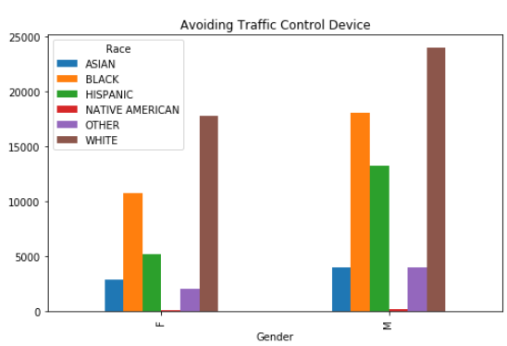
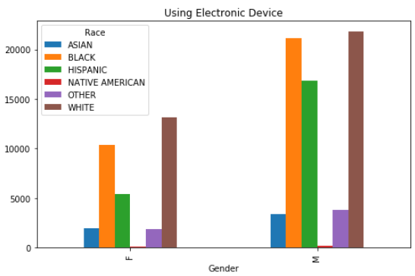
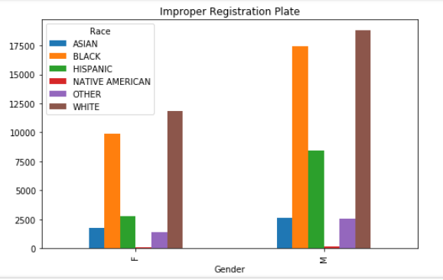
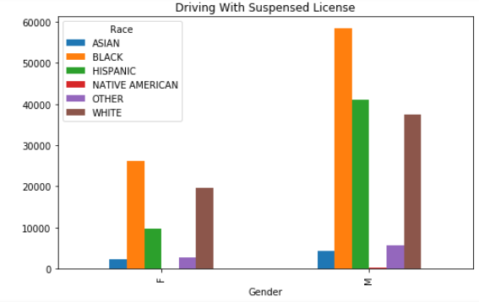
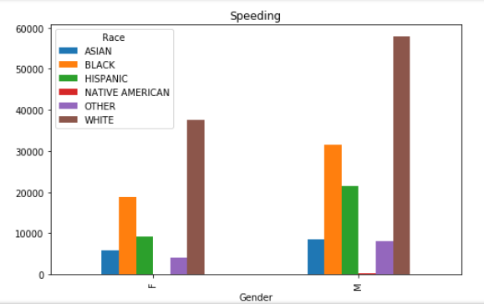
Top Five Traffic Charges by Race and Gender
Limitation: No conclusion can be drawn from the charts below since they are not correlated with the overall population of each demographic. To address this limitation, we picked DUI and Using Electronic Device and data from Census to make the required correlation.

Slide 12
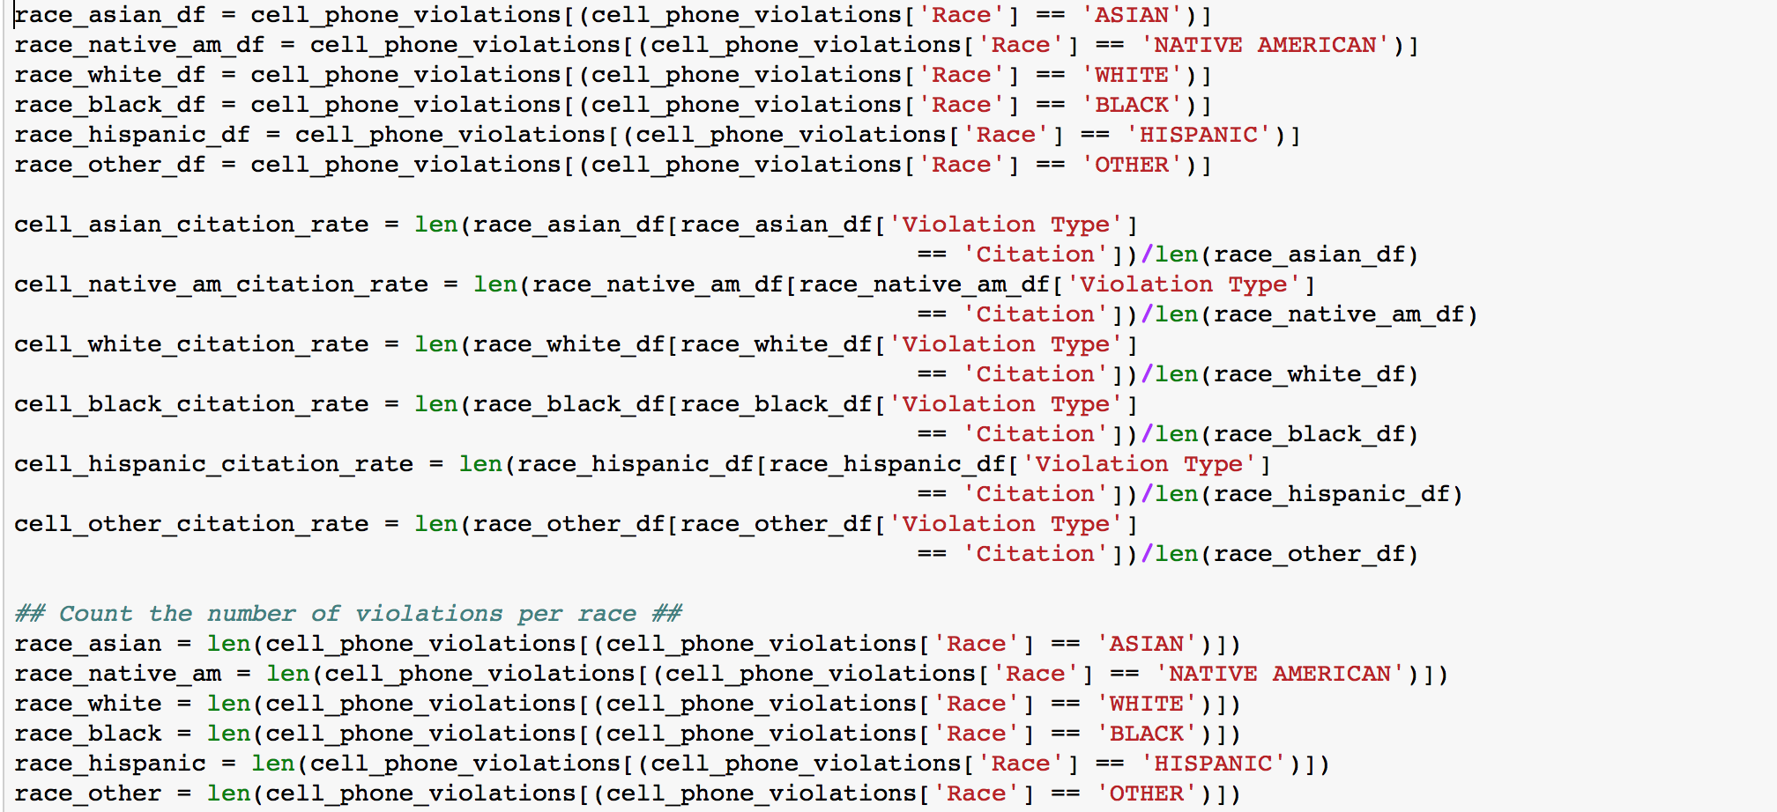
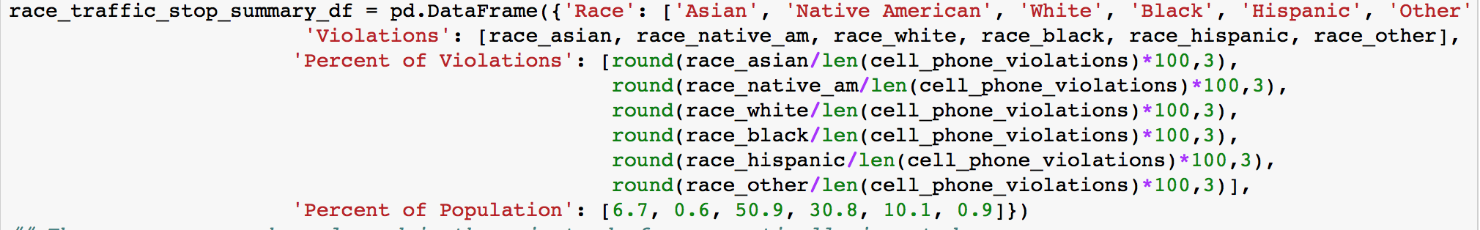
Electronic Device Use by Race - Normalized
Build Data Frame for race and Electronic Device Use:
Create Data Frame of percentage of violations vis population:
Notes: Traffic Stops per Demographic = Citations% by race / %Population.
Population percentages are hard coded using Census data

Slide 13
Electronic Device Use by Race - Normalized
Build Data Frame for race and Electronic Device Use:
Create Data Frame of percentage of violations vis population:
Notes: Traffic Stops per Demographic = Citations% by race / %Population.
Population percentages are hard coded using Census data

Slide 14
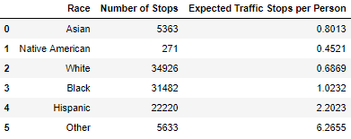
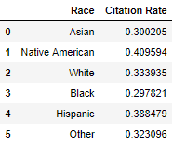
Electronic Device Use by Race - Conclusion
Result of race and percentage of violations vis population Data Frame:
Conclusions:
African Americans are less likely to be cited compared to whites; they are more likely to be pulled over but less likely to be cited.
This seems to indicate that police stops African Americans with the intent of finding something else.
If true then this may show deliberate harassment of African Americans drivers.
Native Americans make up such a small portion of the population. Their citation rates are not as significant but does deserve more in depth attention in future studies.

Slide 15
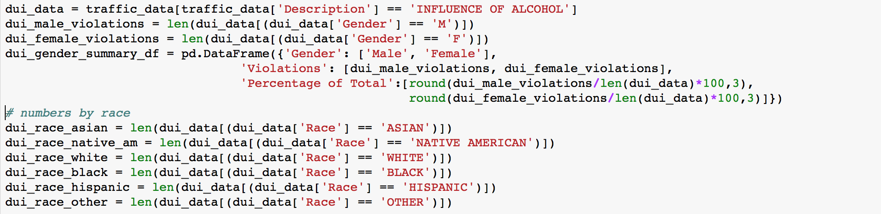
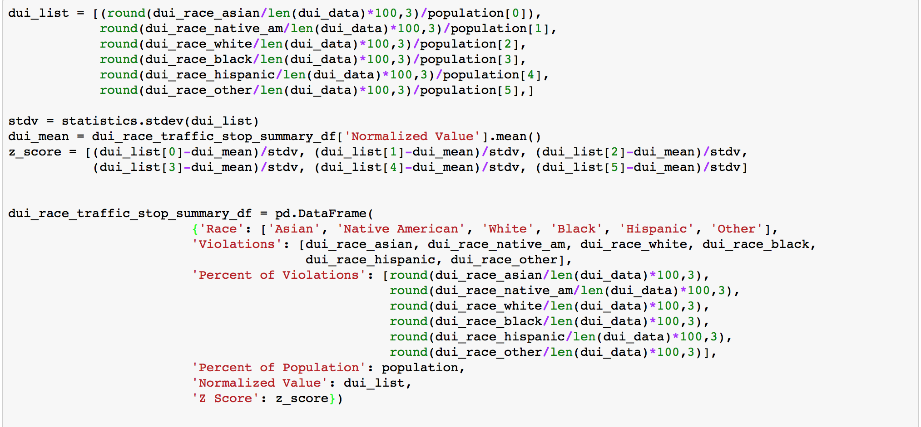
DUI by Race - Normalized
Build Data Frame for DUI:
Create Data Frame of percentage of violations vis population:
Notes: Traffic Stops per Demographic = Citations% by race / %Population.
Population percentages are hard coded using Census data

Slide 16
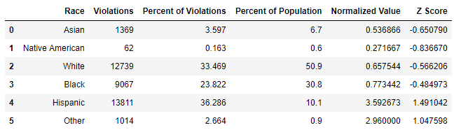
DUI by Race - Conclusion
Result DUI and percentage of violations vis population Data Frame:
Conclusions:
Based on the calculated z-score for each demographic, Hispanics are more likely to be stopped for DUI.
The overall citation rate for each demographic however, is about 99%. So, the above finding is not conclusive.
Additional analysis will be required to draw any conclusions from the above.

